Slide 1
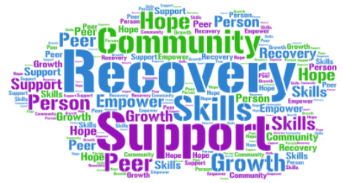
Leveling Up Transitional Care
Join a community dedicated to growth, recovery, and transformation. Whether you're stepping down from treatment or stepping up to a new chapter, Leveling Up Transitional Care offers the structure and support you need.
Our Mission
Contact Us
At Leveling Up Transitional Care, we believe recovery is not just about sobriety—it's about rebuilding a life with purpose, dignity, and connection. We provide a safe, supportive sober living environment integrated with professional therapy and intensive outpatient services to help individuals reclaim their strength, rebuild trust, and rise into the next chapter of life—stronger than before.
📍 Address: 2416 Bradley Ave.
Louisville, KY 40217
📞 Angelia Roland (812) 704 – 9620
📞 Lorene Barnes
(502) 403 – 7813 levelingupward2023@gmail.com

Slide 2
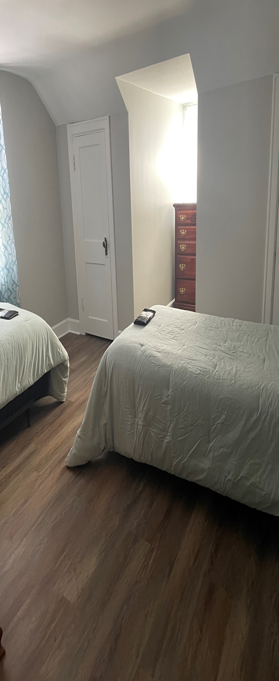
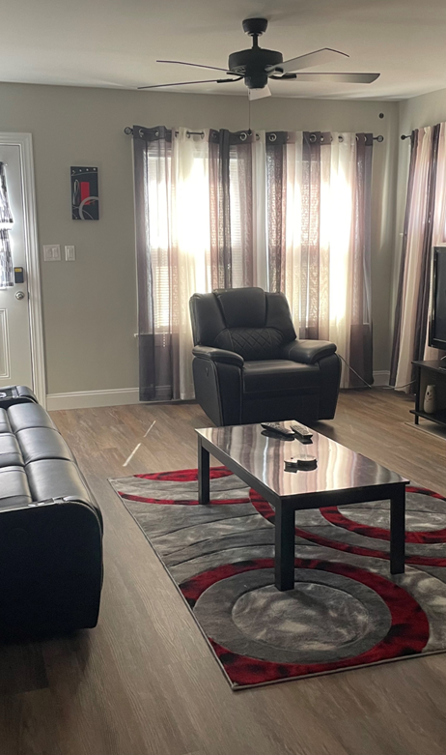
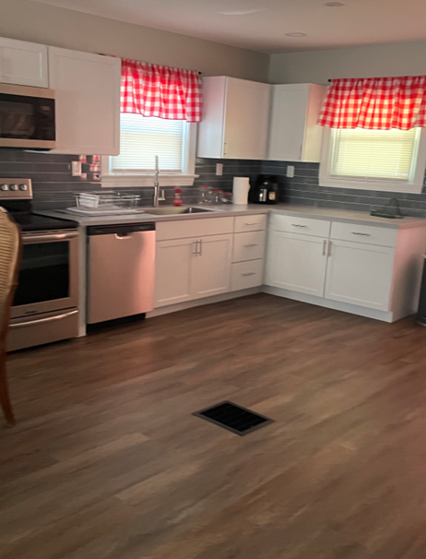
Why Leveling Up?
Inside the House
Why Sober Living?
Our homes feature: - Fully-equipped kitchens - Clean, cozy bedrooms - Comfortable shared spaces - Thoughtfully designed for healing
- Individual Therapy - Peer Support - Life Skills Development - Safe & Supportive Housing
Intensive Outpatient Program (IOP)
✓ Supportive Community ✓ Structured Environment
Focus on Recovery
Role in Recovery
Sober living houses provide essential support for individuals in recovery, helping them transition to independent living.
Benefits of Sober Living
These houses offer a safe space, accountability, and peer support, which are crucial for maintaining sobriety.
Challenges Faced
While beneficial, sober living houses can pose challenges such as conflicts among residents and adjustment issues.
We combine the comfort of sober living with clinical support: ✓ Real-world accountability ✓ Licensed professionals ✓ Recovery community focus

